Slide 1


Slide 2



National Center for Educational Quality Enhancement Annual
International Conference 2023, Georgia, 27 February 2023
Measuring and Comparing Achievement of Learning Outcomes in Higher Education in Europe
TUNING CALOHEE – Linking Evaluation of Learning Outcomes to Quality Assurance Mechanisms
Robert Wagenaar
Director International Tuning Academy,
University of Groningen

Slide 3

Key instruments for Quality Assurance
Two key instruments for high quality comparable and compatible programmes:
European Credit Transfer and Accumulation System (ECTS)
Qualifications Frameworks for the short, first, second and third cycle
These instruments are the foundation for the:
Standards and Guidelines for Quality Assurance in the EHEA
ESG:
Why?: Building trust and confidence / assure quality
How?: Applying the student centred approach
What?: Covering the actual learning
WHAT question is key for admission, recognition and credit mobility !

Slide 4
Peer reviewing and Qualifications Frameworks
WHAT?: For deciding whether the learning is meeting (inter)national standards ESG uses the instrument of PEER Reviewing
Peer reviewers are using European and National Qualifications Reference Frameworks as their references
Programme learning outcomes should be meeting standards ESG / Qualifications Frameworks
This raises questions and concerns!
Europe deals with two sets of overarching frameworks and related national frameworks
Frameworks were approved in the period 2005-2008 (and have not been updated)

Slide 5
Role of Qualifications Frameworks
THE CHALLENGE

Slide 6
Tuning-CALOHEE Qualifications Reference Frameworks
Need for revisiting existing frameworks - Need for full
alignment
Rational
Existing two European overarching frameworks:
Framework for Quality of EHEA (20 years of age)
European Qualifications Framework for LL (15 years)
Revised Tuning Subject Area frameworks
Present overarching frameworks do not take account of: digitalization, current modes of communication, job market disruption and flexibilization, gender equality, sustainability of societies, climate change, etc.
Message: Existing frameworks require fine-tuning and updating

Slide 7
Role of Qualifications Frameworks
THE RESPONSE

Slide 8

Tuning-CALOHEE Qualifications Reference Frameworks
Merger / combination of the two overarching European frameworks - EQF for LLL and the FQ of the EHEA - in the Tuning-CALOHEE
General Qualifications Reference Frameworks (GQRF)
Subject Specific Qualifications Reference Frameworks (SQRF)
Tuning-CALOHEE QRF offers a way forward to integrate all mentioned elements in one new model respecting the existing ones.
Aims: Make the Implicit Explicit !
Simplify and Clarify !

Slide 9
Tuning-CALOHEE instruments
CALOHEE Reference Frameworks
New backbone WHAT to be learned to meet:
International agreed standards
Include current developments and are foreward looking
General Qualifications Reference Frameworks (GQRFs)
Subject Area Qualifications Reference Frameworks (SAQRFs)
Subject Area Assessment / Learning Outcomes Reference Frameworks (SAARFs)

Slide 10
CALOHEE Guideline for Quality Assurance (complementing ESG)
Guideline for integrating CALOHEE Qualifications Reference Frameworks in Higher Education Quality Assurance Policies
Relates to following ESG Standards:
PART1:
1.2 Design and approval of prpogrammes
1.3 Student-centred learning, teaching and assessment
1.4 Student admission, progression, recognition and certification
1.9 On-going monitoring and periodic review of programmes
PART 2:
2.1 Consideration of internal quality assurance
2.4 Peer-review experts
2.5 Criteria for outcomes

Slide 11



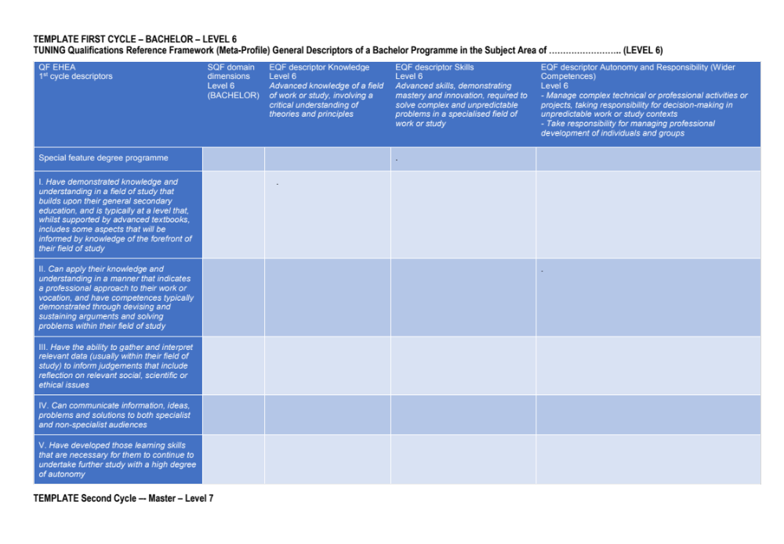
Based on merger EQF for LLL and QF for EHEA
CALOHEE Design: Merger of EQF and FQ of EHEA
Three progressive levels of learning domains
1
2
3
Dimensions: constructive key elements
Knowledge Skills Autonomy and (Knowing) Responsibility

Slide 12
CALOHEE
Basic philosophy of combining the two European QFs
Vertical depth:
Five /six dimensions implying five/six descriptors, which are split up in three parts.
Dimensions for first and second cycle (EQF-levels 6 and 7) are:
  Knowledge and Understanding
  Field related and general / generic skills and competences
  Critical reflection, judgements, synthesizing and design (modelling)
  Communication and information sharing
  Lifelong learning
  Level 8 / third cycle has an additional descriptor: Research
  Each dimension involves a component of ‘knowledge (knowing)’, of ‘skills’ (application) and of ‘autonomy and responsibility’ (operating with authority in work related and societal contexts)

Slide 13


Connections and complexity can be visualized:
CALOHEE General Reference Frameworks
1 2 3
1
2
3
4
5
6

Slide 14
CALOHEE Model
Tuning-CALOHEE General Qualifications Reference Frameworks – GQRFs: Basic principles
Horizontal breadth:
Progression of learning is expressed through three components: ‘knowledge acquisition’ (knowing and understanding), ‘knowledge and skills application’ and developing ‘authority’ (autonomy and responsibility)
Each of these components has its own verb’, for the GQRF respectively: ‘Demonstrate’, ‘Evidence’ and ‘Manifest / Demonstrate’, reflecting the activities involved
Each component requires its own (aligned) teaching, learning and assessment strategies
GQRFs allow for flexibility and tailoring

Slide 15

CALOHEE Design
Tuning-CALOHEE Qualifications Reference Framework model
5 or 6 dimensions combined with three levels of achievement
Knowledge (knowing):
Foundation level of
achievement
Skills: (Application of knowledge): Mediate level of achievement
Autonomy and Responsibility (to be perceived as authority): Most advanced level of achievement

Slide 16
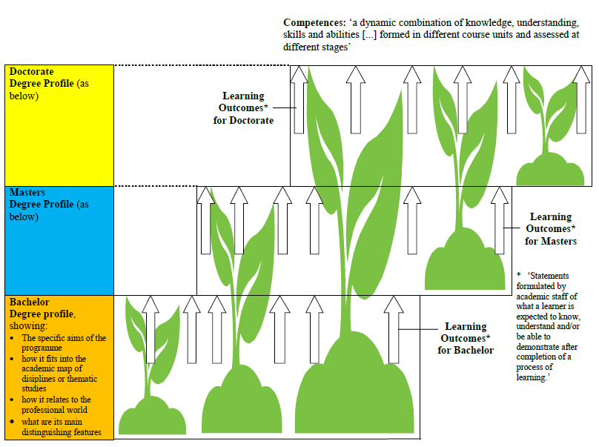
Author: Jeremy Cox, Polifonia Network for Tuning (p38)
16

Slide 17

CALOHEE Design
MULTI-DIMENSIONAL APPROACH:
Flexible model allows for covering different missions and profiles
Example of a research university
(based on profile and mission)
Knowledge: theory and methodology
Application knowledge and skills
Civic, social and cultural engagement
Employability
Example of a university of applied sciences
(based on profile and mission)
Common body of knowledge, skills and wider competences
Shared body
Reference /Assessment framework

Slide 18
Tuning-CALOHEE General Qualifications Reference Framework for Associated Degree
Activity | Knowledge acquisition: domain specific and generic competence | Knowledge and skills application: domain specific and generic technical and non-technical skill | Authority: autonomy and responsibility on the field of study and as a member of society
Knowledge and understanding | Demonstrate comprehensive knowledge and understanding in broad contexts within a field of practice or study, that builds on factual and theoretical knowledge. | Evidence the ability to compile and compare knowledge and information which is fundamental for the field of practice or study applying correctly the related terminology. | Manifest / Demonstrate the ability to use and share field-related knowledge and understanding in field related, professional and societal settings.
Field related and general skills and competences | Demonstrate comprehensive knowledge and understanding of the generic, subject specific, and digital skills required to operate successfully in the field of practice or study and acknowledging the societal context. | Evidence the ability to apply field related and generic skills, including digital ones, in the field of practice or study and societal contexts. | Manifest / Demonstrate an evidence-informed approach to support projects and activities, applying effectively field and societal related knowledge and skills, taking initiative, showing responsibility and personal leadership.
Critical reflection, judgements, synthesising and design | Demonstrate knowledge and understanding of relevant concepts, methodologies and/or practices in the field of practice or study which allows for efficient and effective use in response to a variety of challenges, taking into account basic notions of ethical awareness, intercultural issues, political and governance awareness, decision making, and other societal and sustainable developments. | Evidence the ability to use logic and reasoning in identifying and applying relevant concepts, methodologies and/or practices, while being aware of relevant social, cultural, scientific and ethical issues and challenges. | Manifest / Demonstrates the ability to appraise new knowledge and information to identify and implement individual and collaborative ways forward in response to field related challenges, in the context of societal developments.
Communication and information sharing | Demonstrate knowledge and understanding of the appropriate means and skills to communicate information and challenges related to the field of practice and studies considering selected societal issues for a variety of audiences. | Evidence communication in terms of listening, speaking and writing with regard to different types of information and challenges to a variety of audiences. | Manifest / Demonstrate the ability to communicate effectively in customary workplace and/or societal situations.
Continuous learning and development | Demonstrate knowledge and understanding of learning approaches and methods required for self-directed continuous learning. | Evidence the ability to anticipate the implications of new information and field related and societal developments for both current and future learning. | Manifest / Demonstrate self-motivation and initiative to participate in learning and development activities for oneself, to continually update and upgrade field related knowledge, skill4 and competences.

Slide 19
Tuning-CALOHEE General Qualifications Reference Framework for Bachelor
TUNING-CALOHEE Qualifications Reference Framework for the First Cycle EHEA / Bachelor / EQF Level 6 (Based on a combination of the Bologna Process QF for the EHEA and the European Qualifications Framework for Lifelong Learning)
 | Knowledge | Domain-specific and generic technical and non-technical skill | Autonomy and responsibility in the field of study and as a member of society
Knowledge and understanding | Demonstrate current understanding of a domain of knowledge which defines the field of studies. | Evidence the ability to contextualize, integrate and compare knowledge which is fundamental for the field of study applying correctly the related terminology. | Manifest the ability to use, share, and contribute to field-related knowledge and understanding in professional and societal settings.
Field related and general skills and competences | Demonstrate current knowledge and understanding of the generic, subject specific, and digital skills required to operate successfully in the field of study and wider contexts. | Evidence the ability to apply field related and generic skills, including digital ones, which facilitate critical thinking and evidence-based arguments and solving subject related and societal problems. | Manifest an evidence-informed approach to managing technical / professional projects and activities, applying effectively field and societal related knowledge and skills, taking initiative, showing responsibility and leadership.
Critical reflection, judgements, synthesising and design | Demonstrate current knowledge and understanding of relevant theoretical frameworks, concepts, methodologies and/or practices to gather, evaluate and interpret field related and societal information. This includes ethical awareness, intercultural issues, political and governance awareness, decision making, and other societal and sustainable developments. | Apply appropriate theories, concepts, methodologies and/or practices and field related and generic skills and competences, including digital ones, to analyse, synthesise, and make informed judgments while taking into account relevant social, cultural, scientific and ethical issues and challenges. | Manifest the ability to evaluate and reflect on new knowledge and contribute to discourse to identify and implement individual and collaborative ways to either move forward and/or solve field and societal challenges and problems.
Communication and information sharing | Demonstrate current knowledge and understanding of the appropriate means, skills, attitudes, approaches and strategies to effectively communicate information, ideas, problems, challenges and solutions related to the field of studies and selected societal issues for a variety of audiences, including field specialists, using a variety of media. | Evidence effective communication of different types of information involving ideas, problems, challenges and possible solutions by applying technical and non-technical strategies, means and skills tailoring them to a variety of audiences including field specialists. | Manifest the ability to communicate effectively in predicable and unpredictable workplace and/or societal situations by listening to others and making convincing arguments in order to reach a common understanding of topics and activities involved.
Continuous learning and development | Demonstrate knowledge and understanding of learning approaches and methods required for self-directed continuous learning and development in a variety of formats and settings. | Evidence learning skills and appropriate strategies to advance the continuous learning and development of self and others in order to reflect on, update, and upgrade field knowledge, skill and competences, and societal developments | Manifest motivation and initiative to organise, manage, and evaluate learning and development activities for oneself and others in order to continually update and upgrade field related knowledge, skill, and competences, and societal developments.

Slide 20
Tuning-CALOHEE General Qualifications Reference Framework for Master
Activity | Knowledge acquisition: domain specific and generic competence | Knowledge and skills application: domain specific and generic technical and non-technical skill | Authority: autonomy and responsibility on the field of study and as a member of society
Knowledge and understanding | Demonstrate a depth and breadth of understanding of a domain of specialised knowledge which offers a foundation for developing original thinking and new ideas. | Evidence the ability to contextualise, compare, critique, and integrate specialised knowledge utilised to advance thinking and ideas relevant to the field of study. | Manifest the ability to use and share specialised knowledge and understanding which allow for the development new knowledge, policies and strategic decision making in complex and unpredictable field-related and societal settings.
Field related and general skills and competences | Demonstrate a depth and breadth of knowledge and understanding regarding higher-order generic and subject specific (digital) skills and competences required to operate successfully in a particular field of study at expert level, as well as in a wider societal context. | Evidence the ability to apply higher-order and evidence-informed subject specific and generic skills and competences using appropriate (digital) learning formats, which facilitate the development of high-level critical thinking, complex problem-solving and effective argumentation skills in multi-dimensional and differentiated work and societal settings. | Manifest the ability to effectively apply field and societal related knowledge, skills and competences, including innovation, entrepreneurship, responsibility and/or leadership, to manage complex technical and/or content related activities including projects and initiatives in familiar and unfamiliar work and societal contexts.
Critical reflection, judgements, synthesising and design | Demonstrate a depth and breadth of knowledge and understanding of complex theoretical frameworks, concepts, methodologies and practices at a level which allows for comparing and integrating these, to serve as a foundation for (applied) research and creative thinking related to the field of studies and societal challenges. | Evidence mastery of the ability to identify, analyse, synthesise and compare theories, concepts, methodologies and skills from field related and wider perspectives (including one’s social, ethical, cultural and political responsibilities) to organise often incomplete information, to make evidence-based judgements, and to solve complex problems in research related or innovative contexts. | Manifest the analytical ability to critically comprehend and reflect on new specialised knowledge and skills, and to use this critical capability to contribute in individual and /or team capacities to the identification of evidence-informed judgements and solutions to move forward and /or solve complex field and societal related challenges and problems.
Communication and information sharing | Demonstrate a depth and breadth of knowledge and understanding of the appropriate means, skills, strategies, attitudes and approaches to effectively communicate complex information and multidimensional problems, challenges, ideas and solutions in field related and societal contexts to a variety of audiences, including field specialists. | Evidence the effective application of a variety of sophisticated communication strategies, media, means, and skills to convey different types of information involving multi-dimensional problems, challenges, ideas, and possible solutions through messaging tailored to the target audience, including field specialists. | Manifest the ability to communicate clearly and unambiguously in complex work and/or professional, academic and societal situations, by making convincing and evidence-informed arguments and by listening to and appreciating the view of others.
Continuous learning and development | Demonstrate advanced knowledge and understanding of learning principles, skills and strategies required for largely self-directed autonomous continuing formal, non-formal and informal learning in face-to-face, hybrid and digital formats, in order to keep acquiring new knowledge and insights resulting from work related and societal and sustainable developments. | Evidence advanced learning skills and appropriate strategies to advance one’s own learning and that of others in a lifelong learning context, showing the motivation, metacognitive insight, initiative and leadership to continuously update and upgrade knowledge and field related and generic skills and competences. | Manifest continuous personal and professional development in individual, team-based and societal settings by initiating, organising, managing and evaluating lifelong learning activities for oneself providing good service in a professional context and to society at large.

Slide 21
Tuning-CALOHEE General Qualifications Reference Framework for Doctorate
Knowledge and understanding | Demonstrate state-of-the-art systematic understanding of a domain of specialised field of study and work which offers a robust foundation for developing original research, thinking and/or performance at the frontier of once own field of specialisation and associated ones. | Evidence the mastery of high-level skills and techniques and complex methods to contextualize, integrate, compare and critique state-of-the-art specialised knowledge, thinking and/or performance in formats as currently applied in once own field of specialisation and associated and/or related ones. | Manifest authority and leadership to use and share field-related understanding in complex and unpredictable professional and societal settings which allow for advancing (applied) research and/or developing new knowledge, ideas, policies, processes and strategic decision making.
Field related and general skills and competences | Demonstrate deep understanding of appropriate methods and/or theoretical frameworks for defining a substantial process of (applied) research or ideas development, respecting applicable ethical and scholarly standards and conservation of the environment. | Evidence the ability to conceive, design, implement and adapt a substantial process of (applied) research and/or ideas development by applying an effective combination of domain specific and high-level generic skills, including academic leadership, project and time management, creativity, innovation and entrepreneurship, social and civic responsibility and concern for sustainability, with scholarly and ethical integrity. | Manifest scholarly and professional integrity and sustained commitment in managing complex technical and/or content related activities including projects and initiatives in familiar and unfamiliar environments, e.g. work-based and societal contexts, applying effectively field and societal related knowledge, skills and competences by demonstrating creativity, initiative, innovation, entrepreneurship, responsibility and/or leadership.
Research | Demonstrate deep understanding of conditions and scholarly standards for developing and implementing a highly original and substantial body of research and/or creative work. | Evidence the ability of developing and implementing, autonomously, original research and/or ideas extending the frontier of knowledge and skills application by producing a substantial body of scholarly work as a written publication and/or a substantiated creative (set of) product(s) of which at least part merits national and/or international refereed publication and/or assessment. | Manifest the ability to developing new ideas and/or processes at the forefront of work or study contexts, including state-of-the art science, to address critical issues and complex problems and/or processes in professional and societal settings with integrity and sustained commitment.
Critical reflection, judgements, synthesising and design | Demonstrate deep understanding of complex theoretical frameworks, concepts, methodologies and/or practices at a level which allows for critically analysing, evaluating, comparing and synthesising these to serve as a foundation for (applied) research, creative thinking and developing of new insights and original ideas related to the field of studies and challenging societal topics. | Evidence the ability to identify and compare complex theories, concepts, methodologies and/or practices and high-level skills from one’s own academic field as well as related fields to critically analyse, evaluate, compare and synthesize their usefulness to develop original and creative thinking which results in new insights and original ideas, field of studies and/or societal related. | Manifest metacognitive insight and analytical ability to critically appraise and reflect on new specialised skills and knowledge and field and societal related complex challenges and issues and contribute in discourse and teams to arrive to new insights and ideas which offer ways forward and/or address challenges and problems in complex and multi-dimensional settings.
Communication and information sharing | Demonstrate deep understanding of the appropriate means, skills, strategies, attitudes and approaches to communicate effectively complex information, multi-facial ideas, and multidimensional problems, challenges and solutions related to once own and related fields of studies and selected societal issues for a variety of audiences, ranging from an informed general audience to field specialists and once peers. | Evidence effective communication of various types of information involving multi-facial ideas and multi-dimensional problems, challenges and solutions by applying sophisticated strategies, means and skills tailored to a variety of audiences covering an informed general audience, field specialists and once peers. | Manifest, in complex workplace and/or societal related situations, including academia, the ability to communicate clearly and unambiguously about complex issues, using a variety of strategies to make convincing and evidence-informed arguments and by listening to others with the purpose to develop support and possibly agreement by integrating a variety of viewpoints and opinions.
Continuous learning and development | Demonstrate deep understanding of best strategies to promote, share and discuss effectively new technical, social-economic and cultural insights in once work environment and related context(s), with the aim to contribute to the knowledge-based society, taking into account societal challenges, such as gender equality, intercultural issues, political and governance awareness, decision making, and sustainable development. | Evidence the use of strategic means to promote, share and discuss effectively science based technological and societal developments, which are at the forefront of knowledge, taking the welfare of the workplace and society at large as its reference. | Manifestcontinuous personal and professional development at the most advanced level of knowledge resulting from state-of-the-art knowledge and/or (creative) thinking, in individual, team-based and societal settings by initiating, organising, managing and evaluating activities to contribute to a knowledge-based society as well as welfare of society.

Slide 22
In conclusion
(Tuning-CALOHEE) Generic Qualifications Reference Frameworks in conjunction with the Subject Area Reference Qualifications Reference Frameworks offer a robust basis for:
Programme Learning Oucomes
Course unit Learning Outcomes
which could follow the same model to be entered in Diploma Supplement / Transcript / Digital Learning Records
These GQRFs are expected also to be of high relevance for positioning Micro-Credentials.

