Slide 1




National Center for Educational Quality Enhancement Annual
International Conference 2023
Students Role in the Development of HE Quality Internal Mechanisms - EU and Georgian Case Studies
Speakers: Horia Onita - European Students’ Union (ESU)
Nika Tikanashvili – Georgian Student Organizations
Association (GSOA)
Tbilisi 2023
27-02-2023
NCEQE International Conference 2023

Slide 2
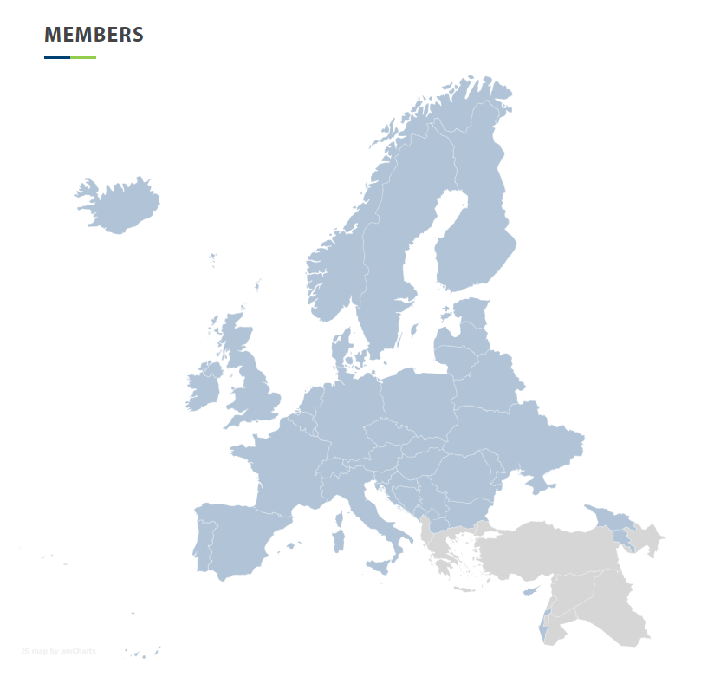
The European Students’ Union (ESU)
The European Students' Union (ESU) is an umbrella organisation of 46 National Unions of Students (NUS) from 41 different countries. Through its members, ESU represents almost 20 million students in Europe
The NUSes are open to all students in their respective country regardless of political persuasion, religion, ethnic or cultural origin, sexual orientation or social standing
Our members are also student-run, autonomous, representative and operate according to democratic principles
27-02-2023
NCEQE International Conference 2023

Slide 3
The European Students’ Union (ESU)
Aim
Represent and promote the educational, social, economic and cultural interests of students at the European level towards all relevant bodies and in particular the European Union, Bologna Follow Up Group, Council of Europe and UNESCO. Through its members, ESU represents almost 20 million students in Europe.
Mission
Represent, defend and strengthen students’ educational, democratic and political and social rights. ESU will work for sustainable, accessible and high quality higher education in Europe.
Vision
Equal educational and social opportunities in an open and democratic Europe where students shape a sustainable future.
Values
ESU is diverse, democratic and open-minded.
27-02-2023
NCEQE International Conference 2023

Slide 4
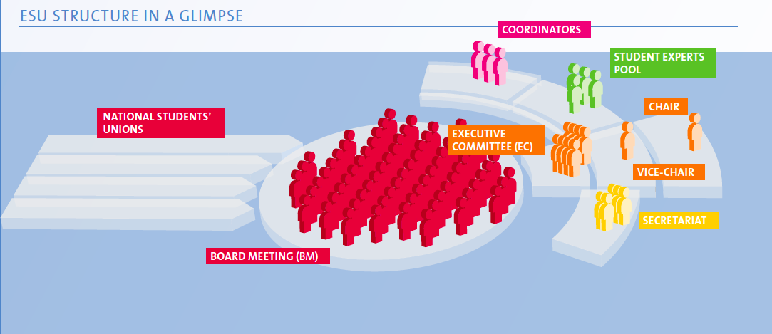
The European Students’ Union
REPRESENTING STUDENTS SINCE 1982
BM approves the ESU’s Budget, Plan of Work and Policies
27-02-2023
NCEQE International Conference 2023

Slide 5
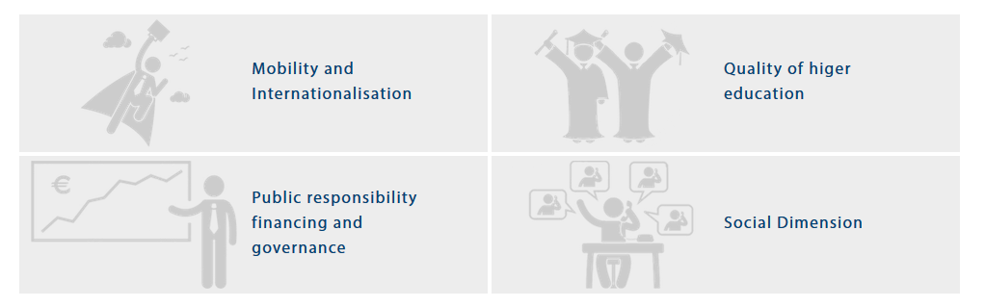
Main Working Areas ESU
Social Dimension: Access and support
Funding and Governance: Public responsibility for education
Quality and transparency: Structural reforms, academic affairs, Quality Assurance, Student Centred-Learning
Mobility and internationalisation
27-02-2023
NCEQE International Conference 2023

Slide 6
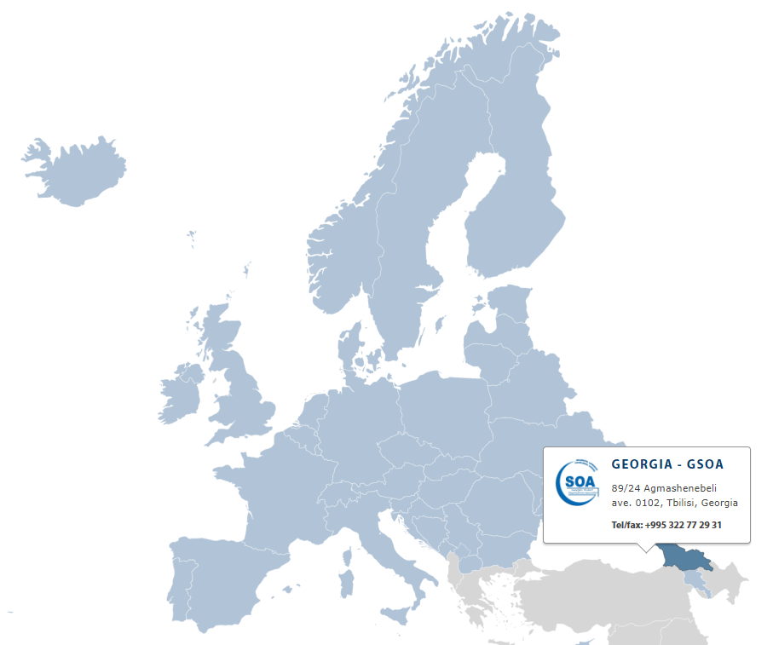

Georgian Student Organizations Association & ESU
Candidate Member of the European Students’ Union
from 08.05.2019.
Full member of the European Students’ Union
from 07.12.2019.
ESU 84th board meeting in Tbilisi May 1-8, 2023 year
27-02-2023
NCEQE International Conference 2023

Slide 7
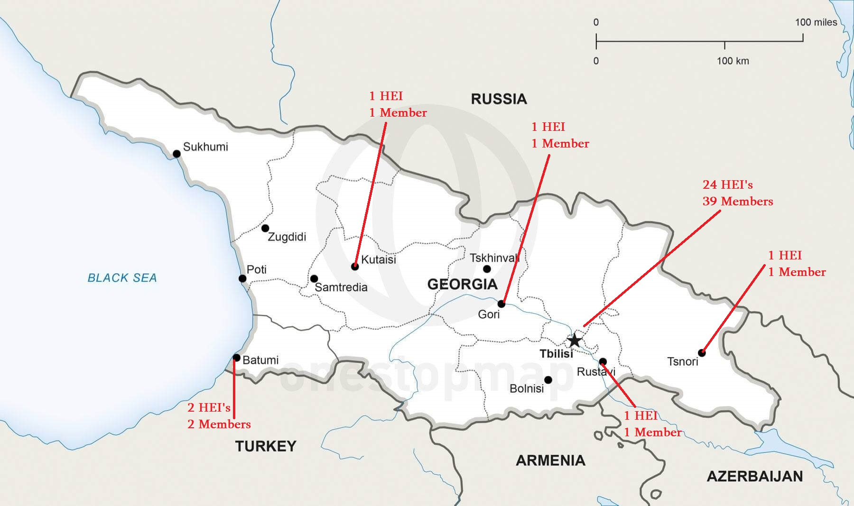
GSOA member HEI’s
27-02-2023
NCEQE International Conference 2023

Slide 8
Main priorities
Participation in higher education quality enhancement
Promoting healthy life-style
Students’ rights protection
International-
isation
and mobility
Equality for all students
27-02-2023
NCEQE International Conference 2023

Slide 9


GSOA participation in HE policy of Georgia
GSOA representatives actively involved as student experts in authorization and accreditation processes in Georgian, also in ESU expert pool on European Level.
GSOA representatives elected in decision making bodies of higher education in accreditation and authorization, national qualifications framework development and NCEQE coordination councils of Georgia.
27-02-2023
NCEQE International Conference 2023

Slide 10
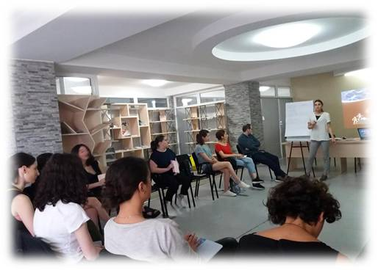
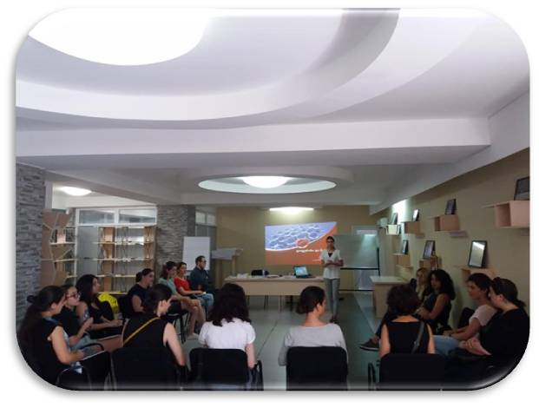
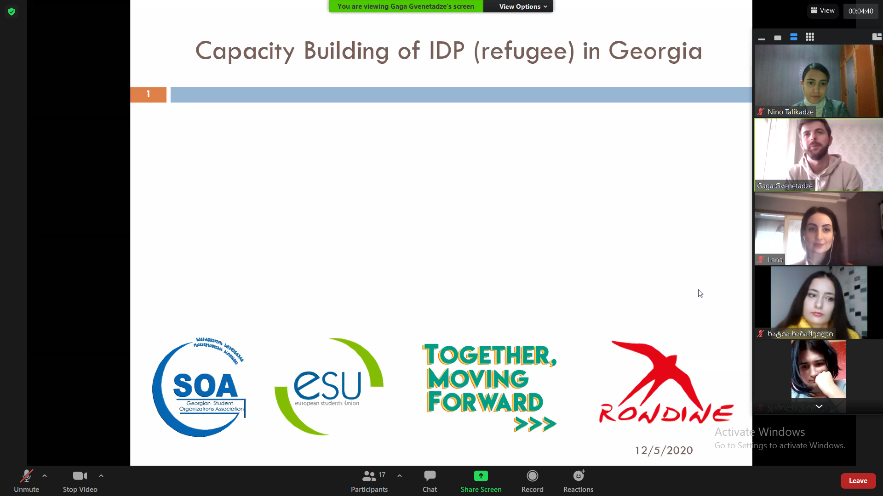
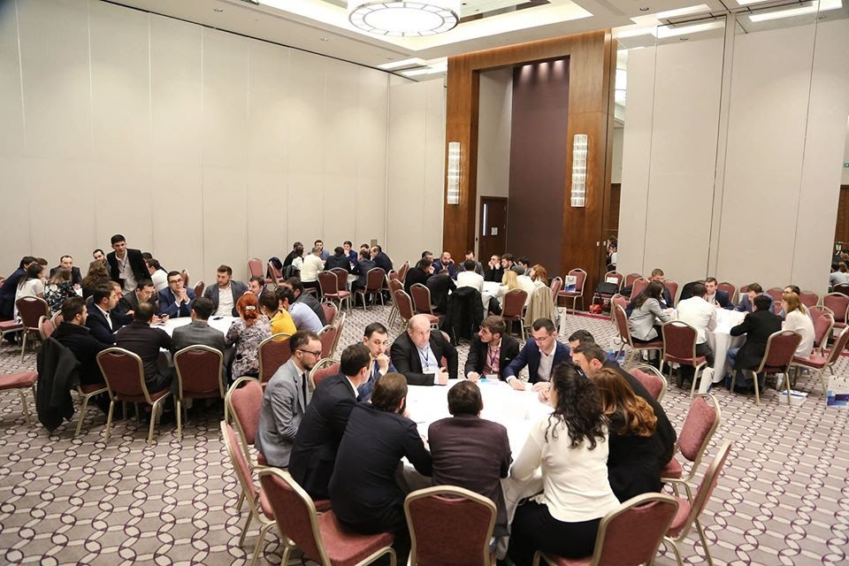
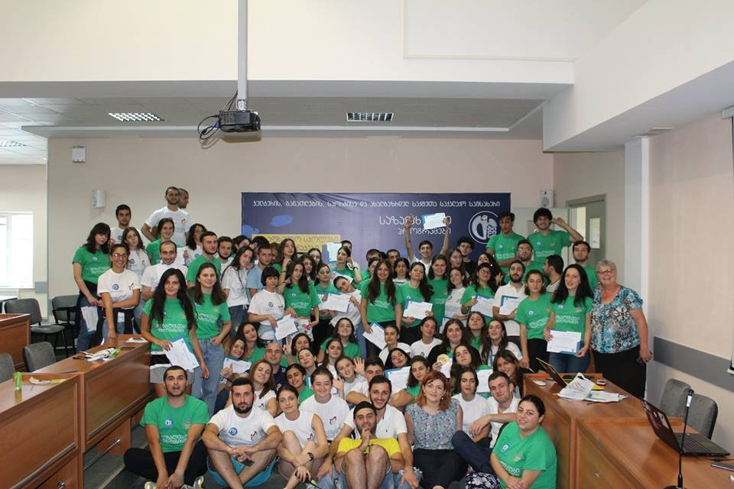

Higher education quality assurance connected activities
27-02-2023
NCEQE International Conference 2023

Slide 11




Student engagement mechanisms in Internal quality assurance processes
Involvement of students at the central and faculty level of higher education institutions
1/3 of the number of students in the representative councils in the state-based higher education institutions, 1/4 in the faculty councils.
Involvement of students in authorization and accreditation assessment processes
Interviews;
Authorization 5 and accreditation 3rd standards.
The need for student representative bodies in all HEIs - in the form of student self-governments (Law about higher Education Annex 45).
27-02-2023
NCEQE International Conference 2023

Slide 12



Students engagement main Indicators for internal QA system assesement
    Participation of students in the development of educational programs and evaluation processes in all directions of activities of higher education institutions
    Student involvement in surveys,
    Focus groups,
    Meetings,
    Working groups,
    Programs and institutions self-assessment teams.
    Work quality of Student Support Services and Career Centers in the university and results.
Open information access for students on domestic grants, exchange programs, international conferences and financing opportunities.
27-02-2023
NCEQE International Conference 2023

Slide 13



Key components of how to assess students' participation in HEI’s internal processes
    Accreditation standards:
    3.1/3.2 Students consulting services and supervision:
    Statistical data about various projects and the students involved in them;
    The student receives appropriate counseling on planning the educational process, improving academic achievements, employment and career development.
    Within the program, students have the opportunity to participate in local and international projects, events, conferences and researches; also take advantage of international mobility.
    5.1. Internal quality assessment:
    Student profiles, student progress, status suspension and termination rates, student satisfaction with their program;
    The results of the student survey conducted by the Higher education institutions;
    Results of the interviews with students.
    Authorization standards:
    5.1/5.2 Students and their support measures
    HEI ensures the creation of a student-oriented environment and the protection of their rights;
    Offers students appropriate services, including among the employment promotion mechanisms;
    Provides maximum information of students, implements various events and encourages student involvement in these events;
    In order to improve student support measures, HEI It takes into account the results of the student survey
27-02-2023
NCEQE International Conference 2023

Slide 14
Challenges and planned activities for Students Role Development in the HE Quality Internal Mechanisms
Challenges:
Increasing the role of students in private higher institutions at the level of university management;
Strengthening tools for the evaluation and recommendation of the third accreditation and fifth authorization standard;
Increasing the involvement of international students in internal and external quality assurance processes;
Encouraging universities to identify students of relevant competence and to involve them more in internal quality assurance processes;
Measures how higher education institution implements the results gained by the students feedback;
More active involvement of students in international projects related to quality assurance of higher education.
Planned activities:
Participation of GSOA with student voice in PRODIGE: Project on Digital Transformation of Higher Education in GEORGIA - Erasmus + CBHE;
Organizing student conference and trainings about internal quality development for students;
Surveys and investigations with member unions, active participation;
More thematic trainings for student experts regarding evaluation tools with ESU-EQE involvement;
Organizing special season connected to internal quality mechanisms during ESU 84th board meeting in Georgia and sharing best European practices.
27-02-2023
NCEQE International Conference 2023
Notes:
Erasmus+ Capacity Building in Higher Education (CBHE)

Slide 15
Thank you very much for attention!
27-02-2023
NCEQE International Conference 2023
Notes:
დისკუსია

