Slide 2
European Students’ Union
The European Students’ Union (ESU) is the umbrella organisation of 45 National Unions of Students (NUS) from 40 countries.
The European Students’ Union's aim is to represent and promote students' educational, social, economic, and cultural interests at the European level to all relevant bodies, such as the European Union, the Bologna Follow-Up Group, the Council of Europe, and UNESCO.
ESU represents almost 20 million students across Europe throughout its members.

Slide 3


Slide 4

Importance of student representation
Why should academia put the needs of students first:
Core stakeholder of HE systems
Working in the interest of constituency (students)
Guarding student rights
Maintaining co-ownership of the education system
Focusing on the quality of education and student needs
Learning democracy and participation through hands-on engagement in leadership - responsibility of student movement should come directly from students

Slide 5
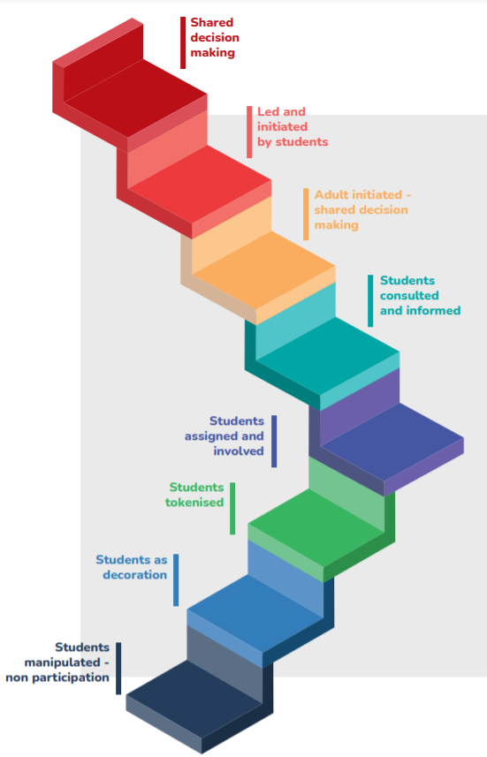
What do we mean by student representation?
Stakeholder participation in governance can be characterised as these “steps”.
Also its worth to remember that achieving certain level of participation does not always mean that its achieved for good.
Student Participation:
innovative practice guide
Guide for effective stakeholder involvement in Quality Assurance
Student Rights Charter
Board meeting ESU80

Slide 6

Stages of stakeholders involvement in QA (ESQA project)
Similarly to the stages of student representation the degree of stakeholders’ involvement in QA also varies and often is not linear.
https://esqa.ro/wp-content/uploads/2020/11/GESIQA.pdf

Slide 7



Slide 8
Student involvement in IQA
Promoting of the culture of quality should take place from the beginning of the study cycle
Students should be encouraged to be critical and reflective regarding their programmes, curriculum planning, assessment, learning environment, study conditions, support systems
The whole student body should be engaged through regular surveys and qualitative means
The whole student body should know the results of evaluations, the follow-up and the impact
Formal participation in QA bodies that ensures a meaningful and impactful participation
Student representatives should be engaged in the whole policy cycle of internal QA: preparation of IQA strategy/plans, implementation, monitoring and evaluation, as well as in the outcomes of IQA: preparation, decision, implementation and evaluation of policies/strategies/measures

Slide 9
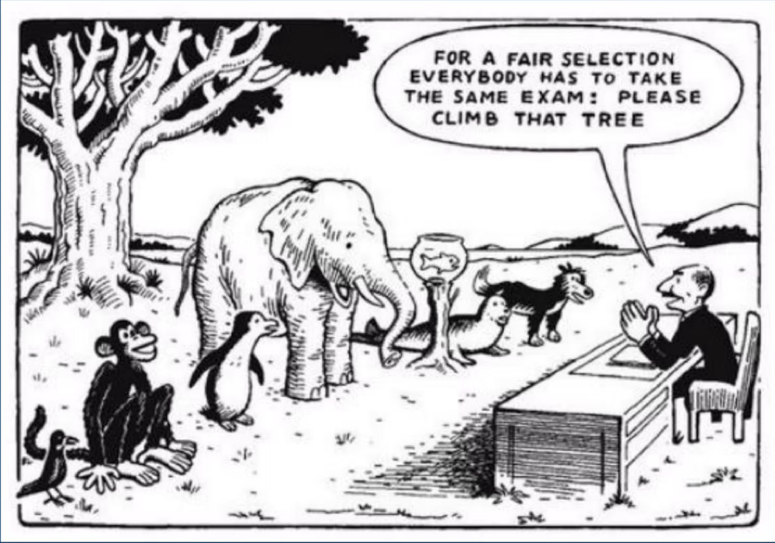
Students should have control over their learning
The best way to ensure that learning focuses more on students is by engaging students themselves in how their learning should be shaped.

Slide 10
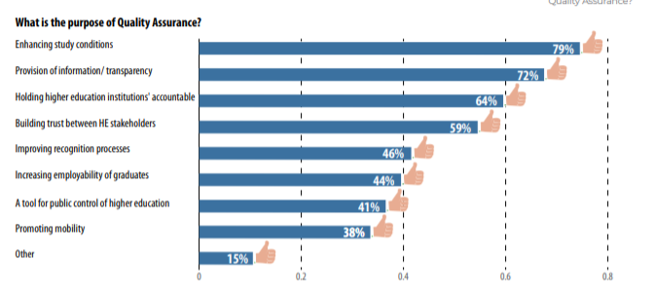
Purpose of QA (BWSE)

Slide 11
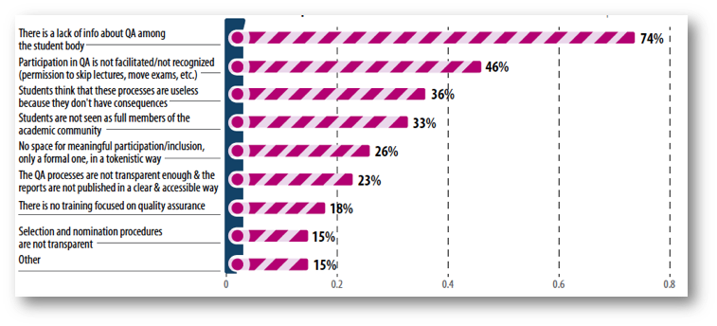
Main barriers of students’ involvement in QA processes
https://www.esu-online.org/wp-content/uploads/2021/01/BWSE2020-Publication_WEB2.pdf

Slide 12
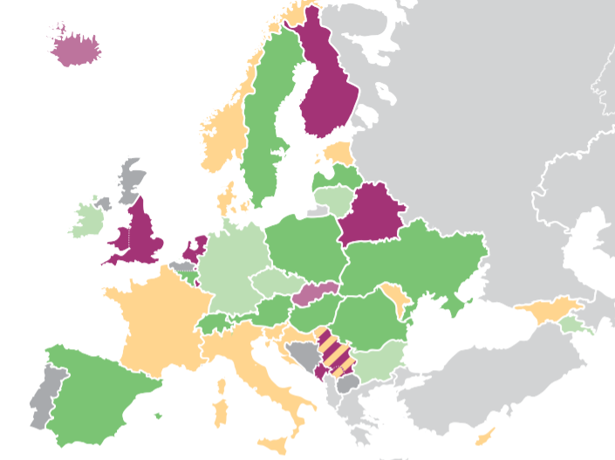
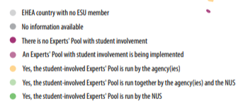
QA Pools - EHEA overview

Slide 13
Challenges for the future of student participation in QA
Better recognition of students’ involvement in QA
Capacity building for students which are not involved in QA
QA of Short and flexible learning opportunities
Strengthening the Student Pools of experts and QA community
Replicating and promoting the good practices regarding students’ impact on study programmes, evaluation and modules
Recognising the learner needs in a new-reality, including the emerging digital/AI tools

Slide 14

Values of Students Involvement in QA and Governance
Students are experts of their own learning and crucial stakeholders
Democracy: people should have a say on policies that affect them
Students become active citizens
Students are constructive partners
Develop students’ understanding of the HE system
Develop autonomy and responsibility skills

Slide 15

Links and contacts

Slide 16
Thank you for your attention!
Horia Onița,
Vice President of ESU
horia.onita@esu-online.org

