Slide 1




National Center for Educational Quality Enhancement Annual
International Conference 2023
Students Role in the Development of HE Quality Internal Mechanisms - EU and Georgian Case Studies
Speakers: Horia Onita - European Students’ Union (ESU)
Nika Tikanashvili – Georgian Student Organizations
Association (GSOA)
Tbilisi 2023
27-02-2023
NCEQE International Conference 2023

Slide 2
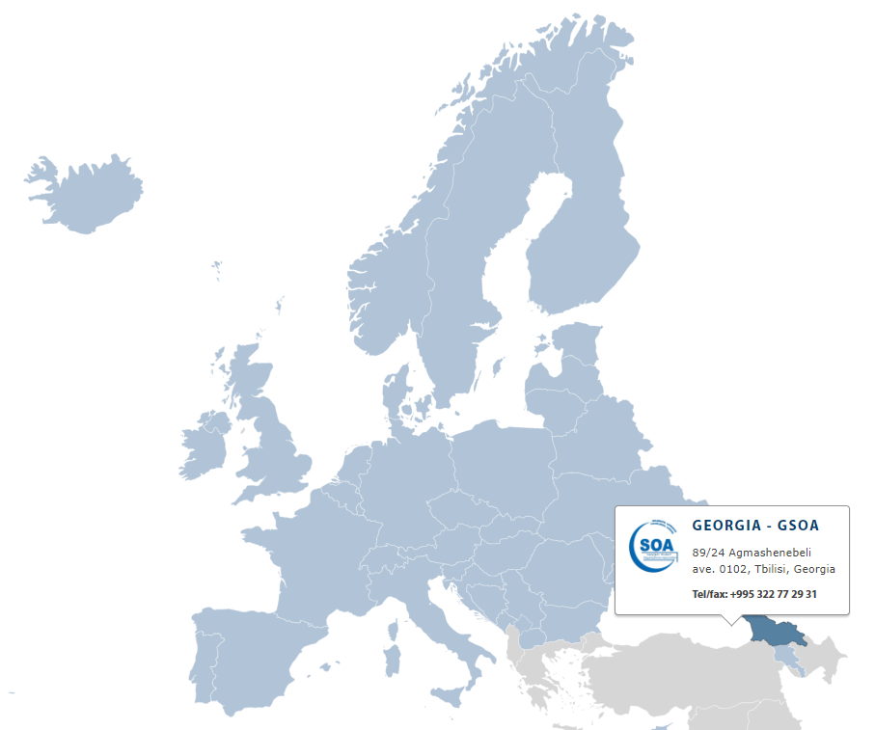

Georgian Student Organizations Association & ESU
Candidate Member of the European Students’ Union
since 08.05.2019.
Full member of the European Students’ Union
since 07.12.2019.
ESU 84th board meeting will be held in Tbilisi during
May 1-8, 2023 year
27-02-2023
NCEQE International Conference 2023

Slide 3
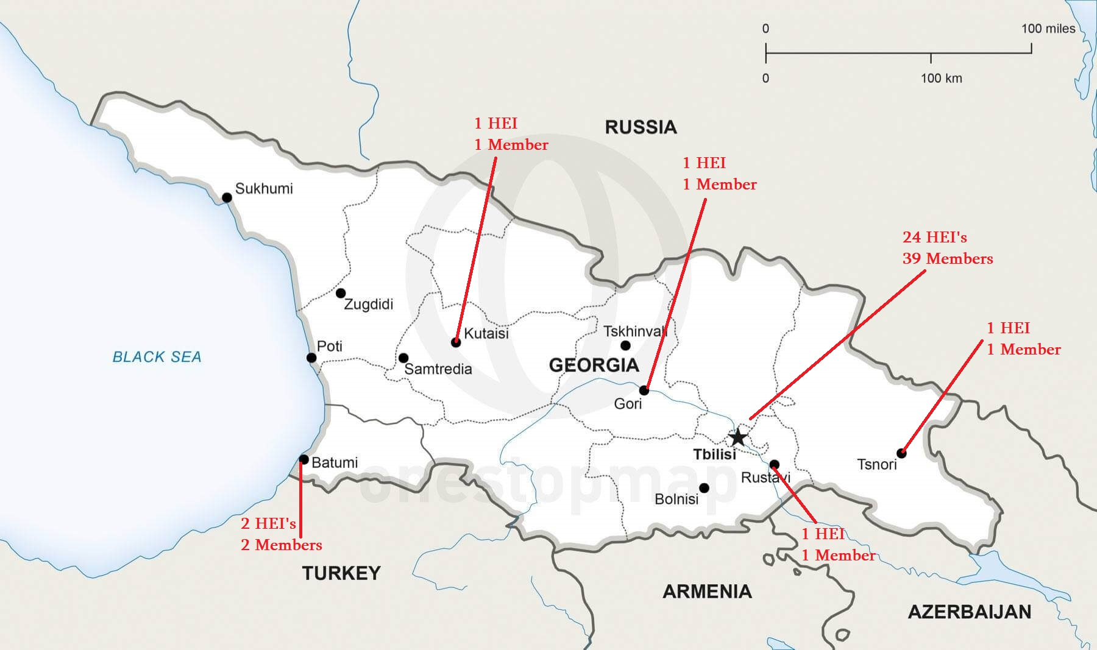
GSOA member HEI’s
27-02-2023
NCEQE International Conference 2023

Slide 4
Main priorities
Participation in higher education quality enhancement
Promoting healthy life-style
Students’ rights protection
International-
isation
and mobility
Equality for all students
27-02-2023
NCEQE International Conference 2023

Slide 5


GSOA participation in HE policy of Georgia
GSOA representatives actively involved as student experts in authorization and accreditation processes in Georgian, also in ESU expert pool on European Level.
GSOA representatives elected in decision making bodies of higher education in accreditation and authorization, national qualifications framework development and NCEQE coordination councils of Georgia.
27-02-2023
NCEQE International Conference 2023

Slide 6
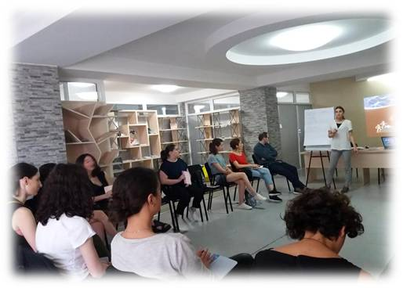
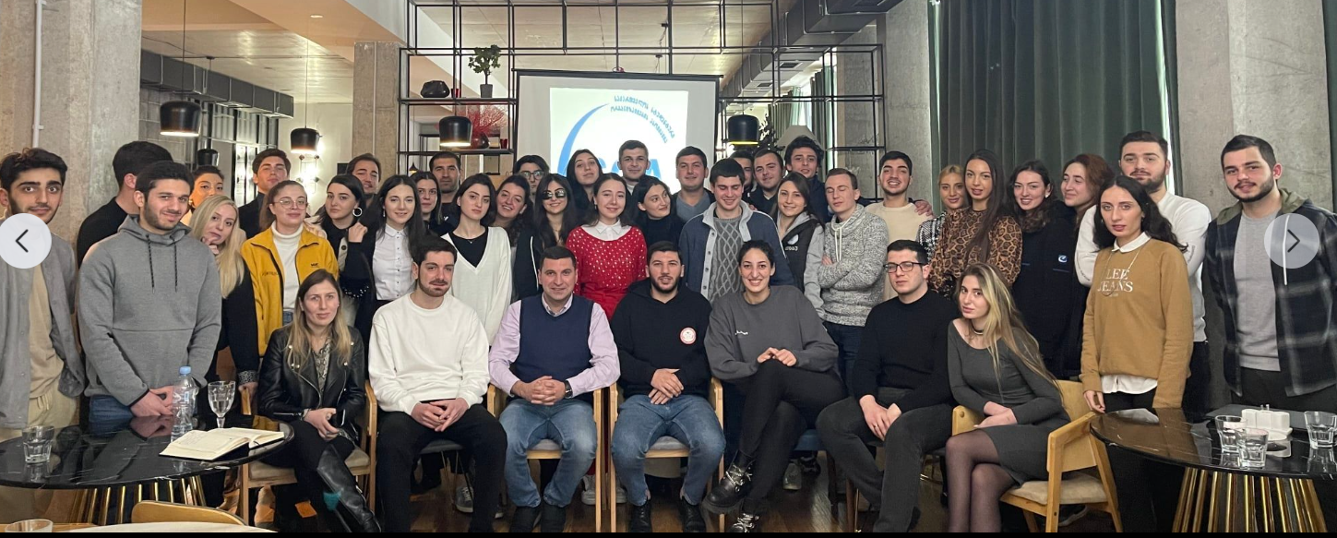
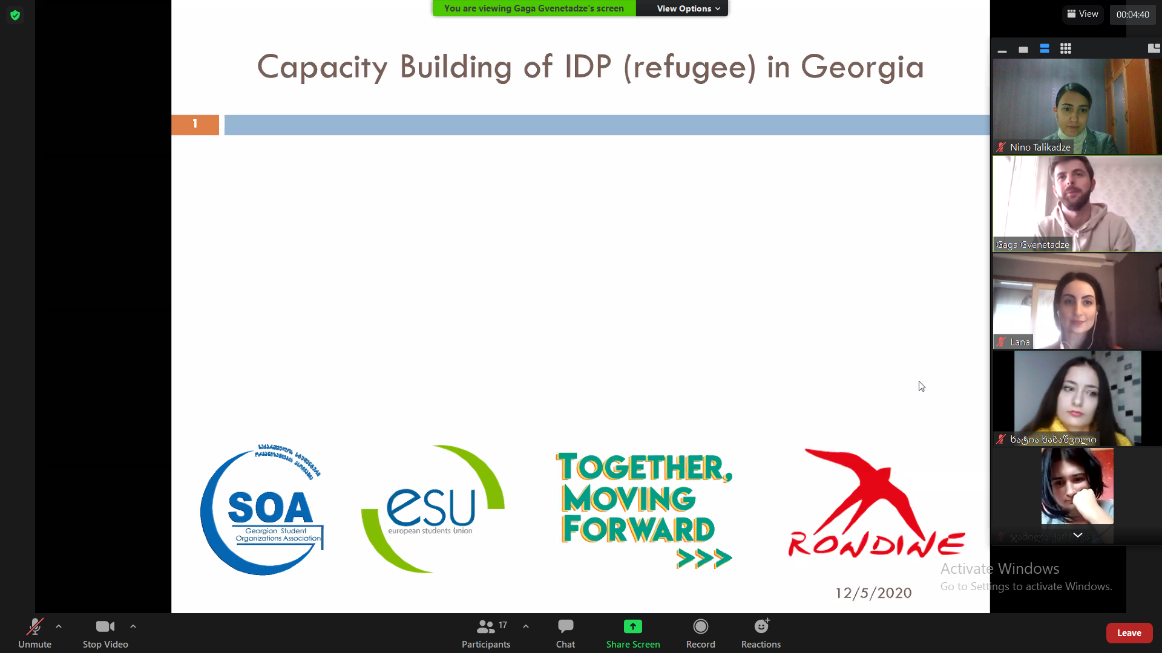
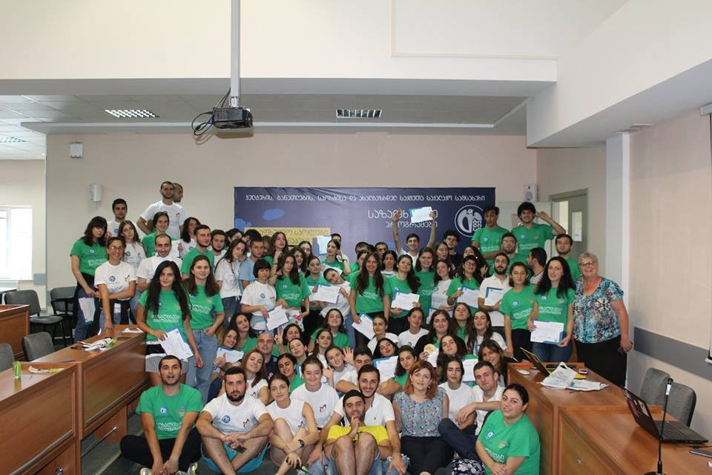
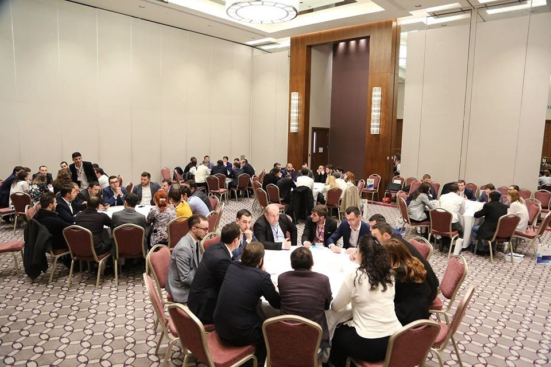
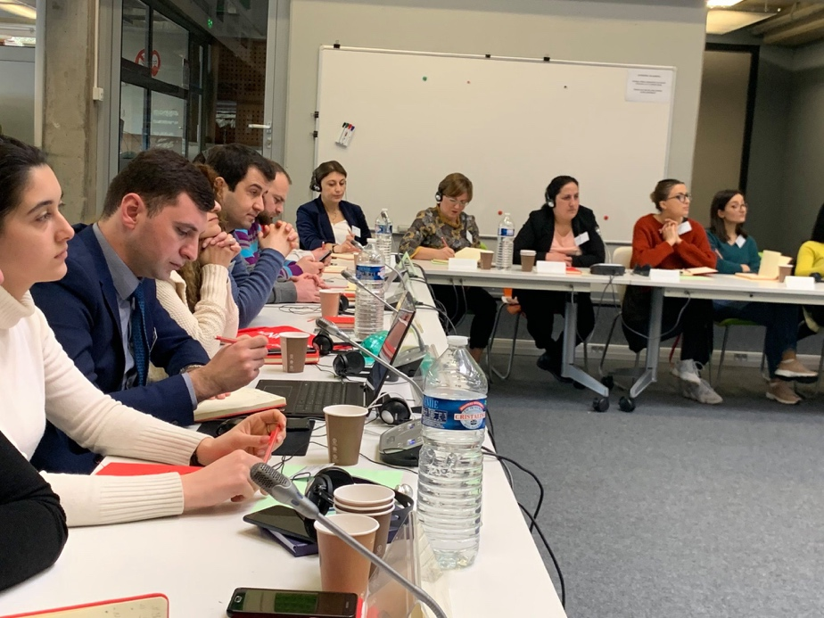
Higher education quality assurance connected activities
27-02-2023
NCEQE International Conference 2023

Slide 7




Students engagement mechanisms to IQA processes in Georgia
Involvement of students at the central and faculty level of higher education institutions
(law about higher education annex 27)
1/3 of the number of students in the representative councils in the state-based higher education institutions, 1/4 in the faculty councils.
Involvement of students in authorization and accreditation assessment processes (National standards)
Interviews;
Authorization 5th and accreditation 3rd standards.
The need for student representative bodies in all HEIs - in the form of student self-governments (Law about higher Education Annex 45).
27-02-2023
NCEQE International Conference 2023

Slide 8



Students engagement main Indicators for IQA system assessment
    Participation of students in the development of educational programs and evaluation processes in all directions of activities of higher education institutions
    Student involvement in surveys;
    Focus groups;
    Meetings;
    Working groups;
    Students in the programs and institutions self-assessment teams.
    Work quality of Student Support Services and Career Centers in the university and results;
Open information access for students on domestic grants, exchange programs, international conferences and financing opportunities.
27-02-2023
NCEQE International Conference 2023

Slide 9



Key components of how to assess students' participation in HEI’s internal processes
    Accreditation standards:
    3.1/3.2 Students consulting services and supervision:
    Statistical data about various projects and the students involved in them;
    The student receives appropriate counseling on planning the educational process, improving academic achievements, employment and career development;
    Within the program, students have the opportunity to participate in local and international projects, events, conferences and researches;
    Participates in international mobility.
    5.1. Internal quality assessment:
    Student profiles, student progress, status suspension and termination rates, student satisfaction with their program;
    The results of the student survey conducted by the Higher education institutions;
    Results of the interviews with students.
    Authorization standards:
    5.1/5.2 Students and their support measures
    HEI ensures the creation of a student-oriented environment and the protection of their rights;
    Offers students appropriate services, including among the employment promotion mechanisms;
    Provides maximum information of students, implements various events and encourages student involvement in these events;
    In order to improve student support measures, HEI It takes into account the results of the student survey.
27-02-2023
NCEQE International Conference 2023

Slide 10
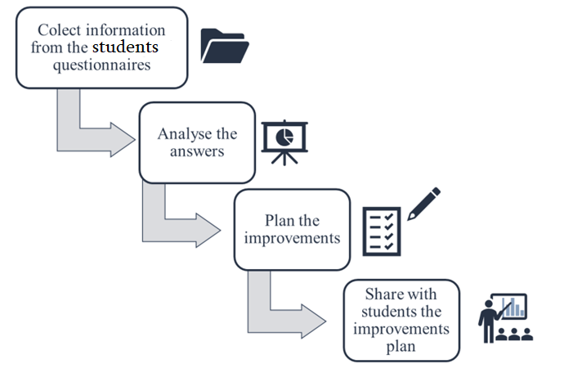
Schematic methodology to encourage students’ participation in the IQA system
Development of strategic and action plans is crucial in the student-centered
education context.
Encourage students to answer the surveys and emphasize their role on IQA.
Students should feel value of their participation, for instance, by means of social media, which nowadays, is the most powerful.
A meeting at the end of each academic year, in which responsible persons exposes to students the results from questionnaires and the measures they are considering implementing in the following year.
Students should capture that, their opinions are taken seriously by the HEI and that is effective in the decision-making process.
HEI should prevent or correct unwanted or unexpected changes, through periodic checks, measuring quality performance against expectations, identifying where the gaps are based on the students requirements.
27-02-2023
NCEQE International Conference 2023

Slide 11
Challenges and planned activities for Students Role Development in the HE Quality Internal Mechanisms
Challenges:
Increasing the role of students in private higher institutions at the level of university management;
Strengthening tools for the evaluation and recommendation of the third accreditation and fifth authorization standard;
Increasing the involvement of international students in internal and external quality assurance processes;
Encouraging universities to identify students of relevant competence and to involve them more in internal quality assurance processes;
Measures how higher education institution implements the results gained by the students feedback;
More active involvement of students in international projects related to quality assurance of higher education.
Planned activities:
Participation of GSOA with student voice in PRODIGE: Project on Digital Transformation of Higher Education in GEORGIA - Erasmus + CBHE;
Organizing student conference and trainings about internal quality development for students;
Surveys and investigations with member unions, active participation;
More thematic trainings for student experts regarding evaluation tools with ESU-EQE involvement;
Organizing special season connected to internal quality mechanisms during ESU 84th board meeting in Georgia and sharing best European practices.
27-02-2023
NCEQE International Conference 2023
Notes:
Erasmus+ Capacity Building in Higher Education (CBHE)

Slide 12
Thank you very much for attention!
27-02-2023
NCEQE International Conference 2023
Notes:
დისკუსია

